Slide 1
School Improvement Plan 2017
Term review report – Hope Vale
Title Page
Insert school logo / images / graphics
Term 2–3, 2020
School Improvement Presentation

Slide 2
Introduction
Purpose
Contents
8 Cycles of school practice implementation
Positive high expectation culture
Program delivery and outcomes

Slide 3

8 Cycles of School Practice implementation

Slide 4
School professional learning
Cycle 1 | Cycle 2 | Cycle 3 | Cycle 4 | Cycle 5 | Cycle 6 | Cycle 7 | Cycle 8
Use data to inform student development decisions. A lesson takes a maximum of 30 minutes to complete.
Name | Position Principal / Instruction coach / Teacher / Teaching assistant | Learning targets |  |  | Review
 |  | Target Y/ N | Module | Lesson | Enrolment Y/N | Progress % | Review
Focus
Impacts
Agreed actions
Notes:
Term Review version

Slide 5
Classroom coaching
Cycle 1 | Cycle 2 | Cycle 3 | Cycle 4 | Cycle 5 | Cycle 6 | Cycle 7 | Cycle 8
Complete all required observations to maintain engagement
Name | Position Teacher / Teaching assistant | Principal | Instruction coach
 |  | Observation |  |  | Coaching
 |  | Student engagement (5 mins) | Effective Teaching (45 mins) | Student engagement (5 mins) | Feedback | Other
Focus
Impacts
Agreed actions

Slide 6
School data review
Cycle 1 | Cycle 2 | Cycle 3 | Cycle 4 | Cycle 5 | Cycle 6 | Cycle 7 | Cycle 8
Use data to inform engagement decisions
Domain | Weekly data management |  |  |  | Term data review
 | Compile SPT data (target: 20) | Update data wall (target: 20) | Data review (target: 20) | Action plan (target: 20) | Analyse term data (target: 2) | Distribute school report (target: 2)
Childhood
Class
Club
Culture
Civics
Community
Focus
Impacts
Agreed actions

Slide 7
Classroom data review
Cycle 1 | Cycle 2 | Cycle 3 | Cycle 4 | Cycle 5 | Cycle 6 | Cycle 7 | Cycle 8
Use data to inform student development decisions
Name | Position Coach / Teacher / Teaching assistant | Weekly data management |  |  |  |  |  |  |  |  |  | Data- driven intervention
 |  | Class |  | Community |  | Club |  | Culture |  | Childhood |  | Data feedback & actions review (target: 20) | Conduct student placement tests
 |  | Record SPT Class data (target: 20) | Update data wall (target: 20) | Record SPT Community data (target: 20) | Update data wall (target: 20) | Record SPT Club data (target: 20) | Update data wall (target: 20) | Record SPT Culture data (target: 20) | Update data wall (target: 20) | Record SPT Childhood data (target: 20) | Update data wall (target: 20)
Focus
Impacts
Agreed actions

Slide 8
School professional conversations
Cycle 1 | Cycle 2 | Cycle 3 | Cycle 4 | Cycle 5 | Cycle 6 | Cycle 7 | Cycle 8
Undertake school professional conversations
Name | Position | Classroom (weekly) |  |  |  | School (term) | Network (term)
 |  | Staff meeting (target: 20) | Data review (target: 20) | Action plan (target: 20) | Awards assembly (target: 20) | Classroom share (target: 4) | Prof. forum (target: 2)
 | Principal
 | Instruction Coach
Focus
Impacts
Agreed actions

Slide 9
Classroom collaboration
Cycle 1 | Cycle 2 | Cycle 3 | Cycle 4 | Cycle 5 | Cycle 6 | Cycle 7 | Cycle 8
Undertake classroom collaboration
Name | Position Teacher / Teaching assistant | Self assessment (target: 2) | Lesson Practise (pedagogy) |  | Lesson practise (lesson) |  | Peer observation (target: )
 |  |  | Sessions (target: 10) | Attendance (target: 100%) | Sessions (target: 10) | Attendance (target: 100%)
Focus
Impacts
Agreed actions

Slide 10
School improvement partnership
Cycle 1 | Cycle 2 | Cycle 3 | Cycle 4 | Cycle 5 | Cycle 6 | Cycle 7 | Cycle 8
Implement school improvement partnerships
Name | Position | School and family compact provided (Y/N) | Monthly |  | Term
 |  |  | Lead school/community improvement plan meeting (target: 6) | Attend inter-agency meeting (target: 2) | Lead CSIP case review (target: 2) | Community/ school data review (target: 2)
 | Principal
 | Instruction Coach
 | Community Coach
Focus
Impacts
Agreed actions

Slide 11
Parent classroom engagement
Cycle 1 | Cycle 2 | Cycle 3 | Cycle 4 | Cycle 5 | Cycle 6 | Cycle 7 | Cycle 8
Engage with family and school community
Name | Position | # students | Term _ |  |  |  | Term _
 |  |  | Total contact (target: min # students) | Home visits (target: 10) | Classroom visits (target: min # students) | Student report card (target: # students) | Total contact (target: min # students) | Home visits (target: 10) | Classroom visits (target: min # students)
Focus
Impacts
Agreed actions

Slide 12
Positive High Expectation Culture

Slide 13
Positive high expectation culture
Leading a positive high expectations culture that leaders, school faculty, students and families and all the community embrace
Name | Term __ |  | Term __
 | Major | Minor | Major | Minor
Focus
Impacts
Agreed actions

Slide 14
Programs

Slide 15
Oz-e English
Teacher | Group | Level | Progress (target: 100%) | Mastery (target: 75%)
Focus
Impacts
Agreed actions

Slide 16
Oz-e English Writing (Language)
Teacher | Group | Level | Progress (target: 100%) | Mastery (target: 75%)
Focus
Impacts
Agreed actions

Slide 17
Oz-e Language
Teacher | Group | Level | Progress (target: 100%) | Mastery (target: 75%)
Focus
Impacts
Agreed actions

Slide 18
Oz-e Maths
Teacher | Group | Level | Progress (target: 100%) | Mastery (target: 75%)
Focus
Impacts
Agreed actions

Slide 19
Oz-e science
 | Teacher | Group | Progress (target: 1 .8 lessons/ week) | Final assessment (target: 80%) | Activity engagement
Biology
 | Teacher | Group | Progress (target: 1 .8 lessons/ week) | Final assessment (target: 80%) | Activity engagement
Chemistry
Focus
Impacts
Agreed actions

Slide 20
Oz-e science
 | Teacher | Group | Progress (target: 1 .8 lessons/ week) | Final assessment (target: 80%) | Activity engagement
Physics
 | Teacher | Group | Progress (target: 1 .8 lessons/ week) | Final assessment (target: 80%) | Activity engagement
Earth and Space Sciences
Focus
Impacts
Agreed actions

Slide 21
Reading Mastery Signature Edition
Teacher | Group | Level | Progress* (target: 100%) | Mastery** (target: 75%) | Students at grade level
* Lesson progress = (Ending lesson– starting lesson)/number of school days in the reporting period
** Mastery = # of occurrences of students passing first time/# of occurrences of students taking the test
Focus
Impacts
Agreed actions

Slide 22
Spelling Mastery Signature Edition
Teacher | Group | Level | Progress* (target: 100%) | Mastery** (target: 75%) | Students at grade level
* Lesson progress = (Ending lesson– starting lesson)/number of school days in the reporting period
** Mastery = # of occurrences of students passing first time/# of occurrences of students taking the test
Focus
Impacts
Agreed actions

Slide 23
Corrective Math Concepts
Teacher | Group | Level | Progress* (target: 100%) | Mastery** (target: 75%) | Students at grade level
* Lesson progress = (Ending lesson– starting lesson)/number of school days in the reporting period
** Mastery = # of occurrences of students passing first time/# of occurrences of students taking the test
Focus
Impacts
Agreed actions

Slide 24
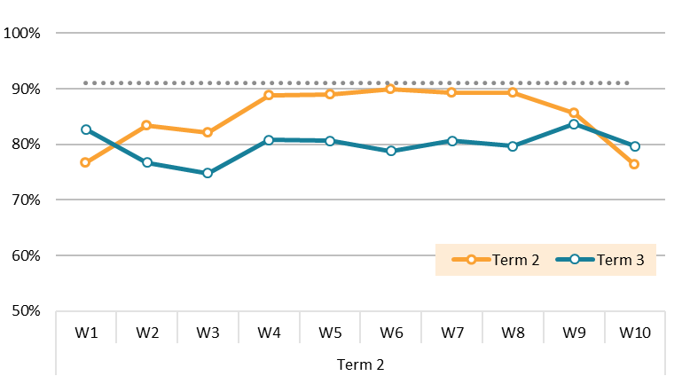
Attendance
Support families to engage in their children’s education and health so that all the children are school-ready
Attendance Term ____, 202__
Term 1 average: 89%
QLD average 91%
-4%
Term 2 average: 85%
-6%
Term 3 average: 80%
<Insert your graph and data>
Images are placeholders only
Focus
Impacts
Agreed actions

Slide 25
Attendance
Support families to engage in their children’s education and health so that all the children are school-ready
Attendance data by teacher, Term 2-3 2020
Attendance 100%
<Insert your graph and data>
Images are placeholders only
Focus
Impacts
Agreed actions

