Slide 1
Using the Student Progress Tool (SPT)

Slide 2
Contents
SPT (Student Progress Tool) introduction | 2
General notes | 3
Location and downloading file | 5
Navigating through the files | 6
SPT form | 10
Completion of other forms | 15

Slide 3
  SPT (Student Progress Tool) introduction
The SPT is used to collect data on student progress throughout the DI program
Why use an SPT?
Project Directors, Implementation Managers, Principals, Coordinators, and Coaches:
  • to analyse the overall status of an implementation
• to continuously monitor mastery and lesson progress
• to determine areas that require change, and to identify solutions
Teachers and Assistants:
• to summarize and report lesson gains, mastery tests, and results
    • to communicate questions or comments relating to the implementation

Slide 4
  General notes
The SPT file contains the entire suite of forms for each program on the one excel file. Previously individual forms and files were retrieved by searching through folders for the specific forms and using multiple excel files. Consolidating into the one file will eliminate unnecessary searching and improve version control and maintenance.
Please do not alter the SPT templates when entering data for schools. The sheets are password protected to ensure data is entered and collected in a consistent and accurate manner.
If errors occur, please contact GGSA to seek help to correct the error.
Always use drop down lists where they exist. Do not add or alter these lists. If there any changes that need to be made, please contact GGSA.
When opening the file, click yes to enable macros if you are prompted.

Slide 5

  General notes
IMPORTANT: Each teacher will only need to submit ONE SPT file for each submission. It is recommended that each file contains the date of the submission and is named in a consistent method (see example below)
  Koala_Primary_SPT_Jane_Citizen_Term1_28-02-2019
Koala_Primary_SPT_Jane_Citizen_Term1_31-03-2019
Koala_Primary_SPT_Jane_Citizen_Term2_15-05-2019
Instructions on navigating through the file and duplicating worksheet tabs are explained in this presentation. The method of submitting files will vary from state to state – please contact your teacher coach for further information.

Slide 6

  Location and downloading file
The SPT file can be found on the Teacher’s Portal
https://goodtogreatschools.org.au/our-products/great-teaching-portal/
Note 1 - If prompted ensure that macros and editing are enabled. File may open as “read only” – to save changes, make sure to save as a Macro-Enabled Worksheet.

Slide 7
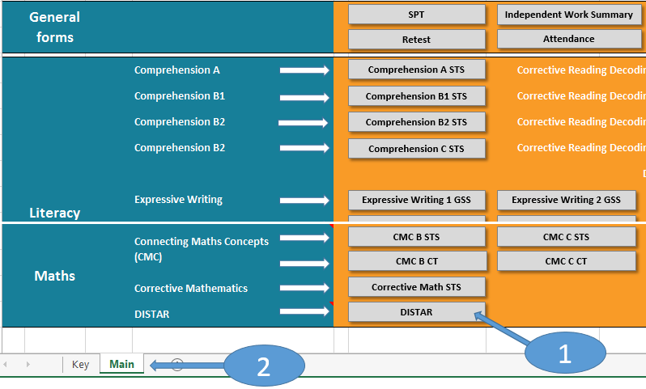
  Navigating through the files
When opening the file for the first time you are presented with all forms on the one spreadsheet. The forms are organised based on three streams (General Forms / Literacy and Maths)
Note 1 above – Press the button on a program to open the associated forms
Note 2 above – The workbook has two spreadsheet tabs upon opening

Slide 8
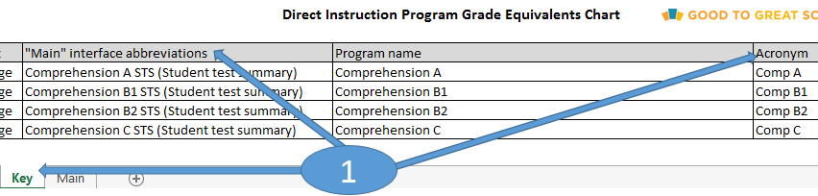
  Navigating through the files
Note 1 above – The “Key” tab references the “Main” interface buttons with both the full program name and Acronym

Slide 9
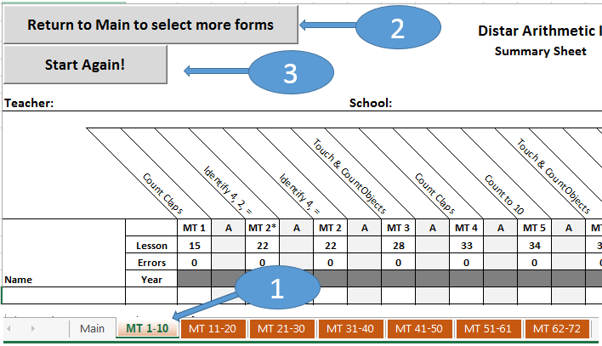
  Navigating through the files
Note 1 – When you select a particular program you will notice the spreadsheet tabs for the associated forms appear along the bottom of the workbook.
Note 2 – If you need to select additional programs / forms you can navigate back to the main tab – by selecting the “Return to main to select more forms” button
Note 3 – If you make a mistake by selecting the wrong program, you can return to the start (by selecting the “Start again!” button). Note this will hide all visible sheets (apart from the “Main” tab)

Slide 10
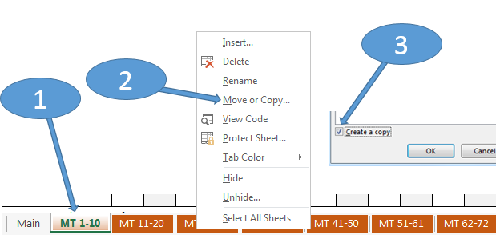
  Navigating through the files
Occasionally you may be required to duplicate forms/worksheets (e.g. for an additional group). The security settings on the workbook do not prevent you from copying spreadsheets.
Note 1 – right click on the spreadsheet to copy
Note 2 – select option Move or Copy
Note 3 – ensure checkbox is ticked and rename worksheet accordingly.

Slide 11
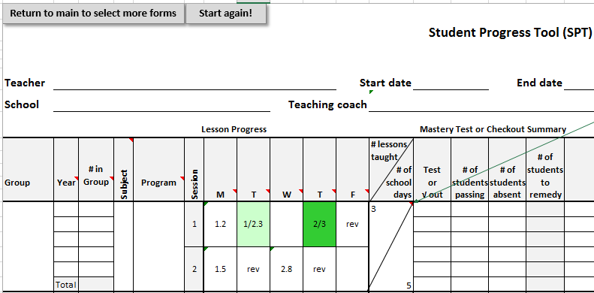
  SPT Form (formerly called the LPC)
The SPT (Student Progress Tool) form has been renamed from the previous LPC (Lesson Progress Chart) form. There have been slight changes to this form to improve data accuracy.
Changes include data restrictions placed on cells to ensure no erroneous data is collected (for example the characters “&”, “-”,”_” and space are disallowed). To accurately record a session where there has been a transition from one lesson to another, be sure to use the “/” to split the lessons (for example completed lesson 1 and part way through lesson 2 in a session would become “1/2.3”)
If a lesson is registered as being “taught” or complete then the individual cell will turn light green. It is possible to register a maximum of two lessons in one session and the cell will turn dark green (eg 2/3 in above example).

Slide 12
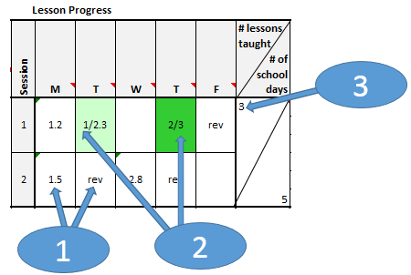
  SPT Form (formerly called the LPC)
Note 1 – Numbers with a decimal, letters combined with numbers or just letters are all valid data entry but “do not” contribute to the total of # lessons taught
Note 2 – “Only whole numbers” contribute to the total of # lessons taught (cell will be highlighted in light green). It is possible to enter two whole numbers for the one session and it will be registered as two lessons taught (this is the maximum allowed for one session and will be highlighted in dark green)
Note 3 – Total is auto calculated. In above the total is three (one sessions with one lesson taught/completed plus one session with two lessons taught).

Slide 13
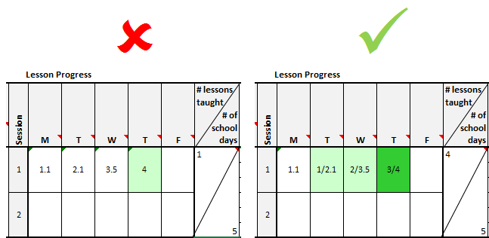
  SPT Form (formerly called the LPC)
In example above, a teacher has completed four lesson (Lessons 1-4)
The example on the left shows the incorrect way to enter the lessons completed. Please note that a whole number is required to be entered to register as complete

Slide 14
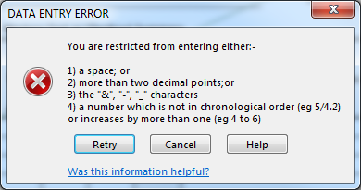
  SPT Form (formerly called the LPC)
Users will receive the above message if invalid data is entered.

Slide 15
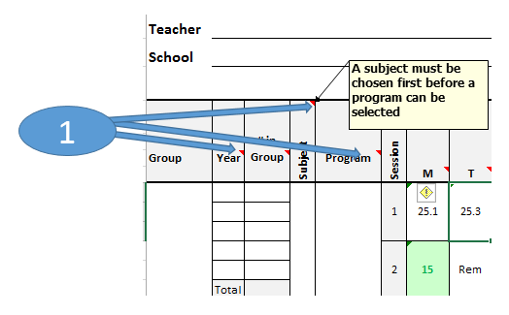
  SPT Form (formerly called the LPC)
Users can find other useful tips by hovering the arrow over cells where there is a comment (which is denoted by a small red triangle in the upper right hand corner of a cell

Slide 16
  Completion of other forms
For correct completion of all other forms associated with specific lessons, please refer to your training manual and/or contact you teaching coach

